Slide 1


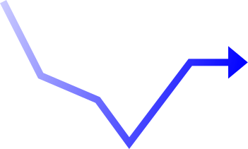

Page 1
COMP 3250 PROJECT, GROUP 5
Data Analysis on Market Timings vs Long-Term Investing

Slide 2

Page 2
Ada Taing - Business/Data Analyst​
Defined investment problem, selected evaluation metrics, interpreted simulation results, and ensured alignment with casual investor needs. ​
Adedeji Adeboyejo - Data Engineer ​
Retrieved ETF data via Yahoo Finance API, cleaned and prepared datasets, calculated indicators, and simulated all six investment strategies. ​
​
Aidan Zhu - Visualization Developer ​
Designed and implemented the interactive Power BI dashboard, ensuring accessibility and clarity for a non-expert audience. ​
​
Mani Manav - Documentation Lead ​
Maintained project documentation and prepared the final written report and video presentation.
Team Members & Roles

Slide 3
Problem Scope
Page 3
The scope of this project is bounded by the following parameters:
Three ETFs analyzed:
- SPY:
- QQQ
- VTI
Historical data spanning 20+ years retrieved from Yahoo Finance
Two strategies: Buy & Hold and Market Timing using a 50-day Moving Average signal (a technical indicator that shows the average price of a stock over the last 50 trading days).
Six portfolio simulations:
Buy & Hold Strategy using just SPY ETF,
Market Timing Strategy using just SPY ETF,
Buy & Hold Strategy using equal investments into each ETF,
Market Timing Strategy using equal investments into each ETF,
Buy & Hold Strategy using a custom investment strategy,
Market Timing Strategy using a custom investment strategy.
Initial investment of $10,000 with biweekly contributions of $500
Performance metrics:
CAGR
Sharpe Ratio
Volatility
Maximum Drawdown
Total Profit
Problem: ​
Many casual investors want to grow their money, but it is not always clear whether they are better off using a market timing strategy or a long-term buy-and-hold strategy.
Main Problem:
When it comes to investing to make a profit, are casual investors better off with market timing or long-term investing?
Goal: ​
The goal of this project was to compare these two strategies using performance and risk metrics, then present the results in an interactive dashboard.
Target users:
Casual investors
Students learning investment analytics
Users interested in comparing investment strategies visually

Slide 4


Page 4
Overall Solution
To answer the project question, we developed a dashboard-based analytics solution that compares Buy and Hold and Timing strategies.
Our solution included:
Rertrieving and preparing the investment data
comparing the strategies using financial performance measures
building an interactive dashboard in Power BI
using visuals and KPI summaries to support interpretation
Metrics used in the comparison:
Final Value
Volatility
Sharpe Ratio
Maximum Drawdown
This allowed us to evaluate both profitability and risk rather than focusing on only one measure.

Slide 5
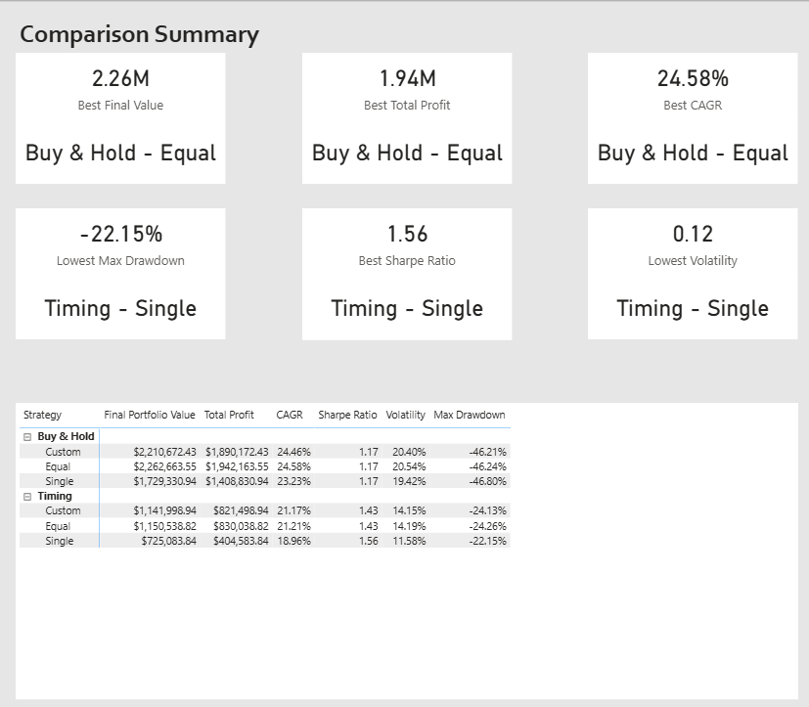
Dashboard Overview
Page 5
Our dashboard was designed to help users compare the two strategies clearly and interactively.
Main dashboard features:
visual comparison of strategy performance
KPI cards for key financial metrics
charts showing strategy outcomes
filters/slicers for easier analysis
multiple pages for different views of the results
Dashboard Purpose
The dashboard helps users quickly identify:
which strategy made the most money
which strategy had the least risk
which strategy was most efficient relative to risk
how severe losses could become

Slide 6
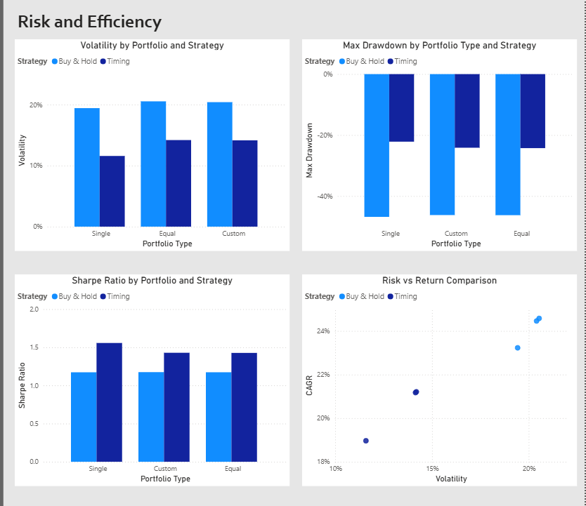
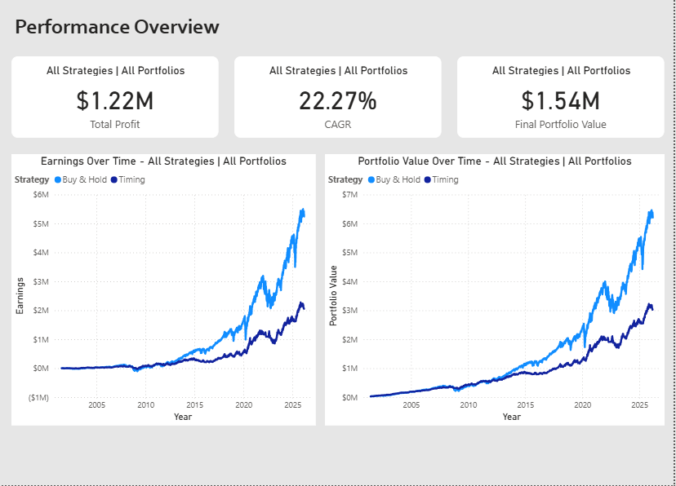
Page 6
​​Dashboard Overview

Slide 7
Page 6
Key Insights
Based on the completed dashboard analysis:
Most money made: Buy and Hold
Least overall risk: Timing
Best risk-adjusted efficiency: Timing had the strongest Sharpe Ratio
What does this mean?
The Buy and Hold performed better when the goal was to maximize total profit.
The Market Timing Strategy performed better when the goal was to reduce volatility, improve efficiency, and limit losses.

Slide 8
Final Answer to the Main Problem
When it comes to investing to make a profit, Buy and Hold appears to be the better strategy for casual investors because it produced the highest overall value.
However, Timing performed better in terms of:
lower volatility
better Sharpe Ratio
smaller major losses
Final Takeaway
There is no single best strategy in every category.
Choose Buy and Hold if the priority is maximum profit
Choose Timing if the priority is lower risk and better risk-adjusted performance

Slide 9

References
Page 9
Data Analytics / Visual Analytics tools:
Power BI: https://learn.microsoft.com/en-us/power-bi/
Data retrieval and cleaning:
Python: https://docs.python.org/3/tutorial/index.html
Datasets:
Yahoo Finance
https://python-yahoofinance.readthedocs.io/en/latest/api.html
https://ranaroussi.github.io/yfinance/
https://finance.yahoo.com/
Project Management Platform:
Hive: https://hive.com/
Github:
https://github.com/AdaTaing/COMP3250-Project

Slide 10
Page 10
Thank You.
Github: https://github.com/AdaTaing/COMP3250-Project

